Slide 1
Harry Ernest Willsher
P.S : Emily’s great granddads cousin.
By Emily Louise Willsher & Eleanor Grace Lamb & Daniel Ethan Spoors

Slide 2
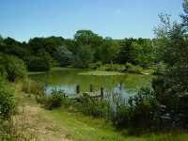
Harry Willsher was born and grew up in Springfield. He then married there to his wife Annie Louisa Turner in 1910.

Slide 3
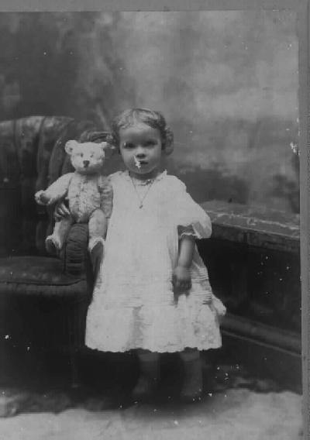
Harry’s children !
He had a daughter, Winfred Ethel Willsher who grew up to be very successful.
Not actually his daughter’s photo

Slide 4
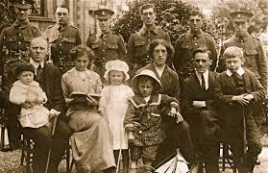
Family
Harry had 11 brothers and 2 sisters , a caring mum and sensitive dad even old grandparents living with him.
Not actually his family photo

Slide 5
In the Army facts!!!!
When he signed up for the army ‘’ The Essex regiment’’ he was 31 he was then sent to France and after spending two days there he was killed in action.
This is a copy of the papers he signed to join the army

Slide 6
In the Army Songs!!!
In the army
You can do what you want
In the army
You can fight how you want
In the army
You can drive a big tank
In the army
You can talk to your friends ( hold notes)

Slide 7
Thank you for watching!!
We hope you learnt a lot!

