Slide 1
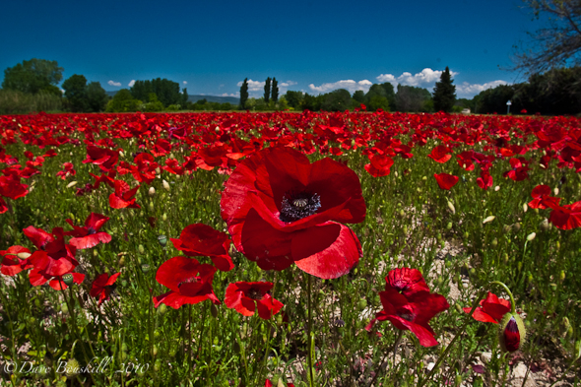
Bertie and George Clark
By class 9

Slide 2
Facts about Bertie Clark
Bertie Clark was born in Springfield on the 12th of July 1891. He was baptized on the 6th of March 1892.He was the oldest brother in the family Bertie was a horseman. He died from wounds on the 12th of July. He got the wounds in The Battle of Some. He was buried in Borre Cemetery in France.

Slide 3
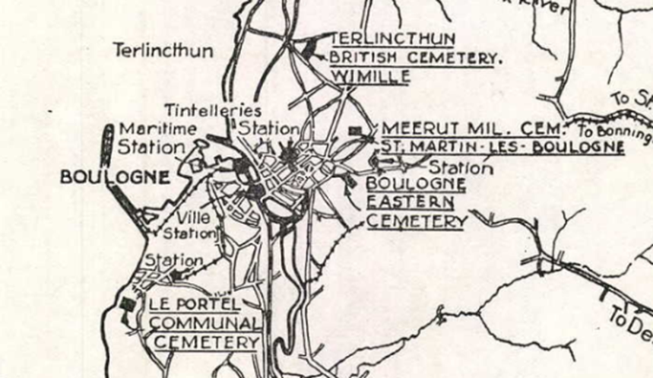

Slide 4
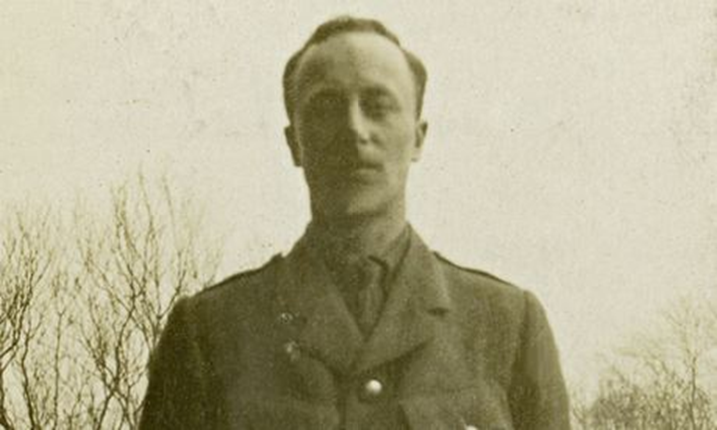
Facts About George Clark
He was born in Springfield 23rd of June 1897. He was baptized 24th of October 1897. He died in a war in 23rd August 1918. He got killed by a gun. After the war his body was discovered. He was buried in Borre Cemetery George also had a half-sister, Louise Fincham.

Slide 5
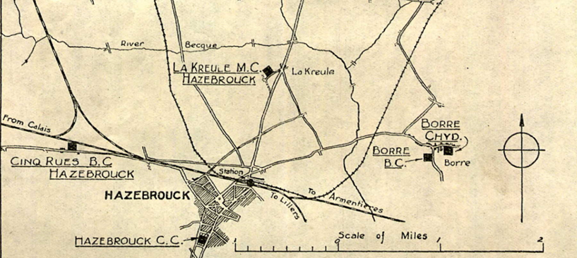

Slide 6
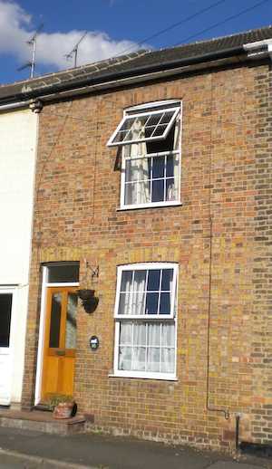
This is George and Bertie’s house on Coval lane.

Slide 7
Thank you for watching!
Any Questions?

