Slide 1
Parent Information Presentation
Year 4
2020 - 2021

Slide 2
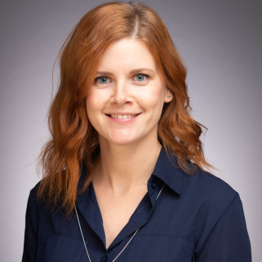
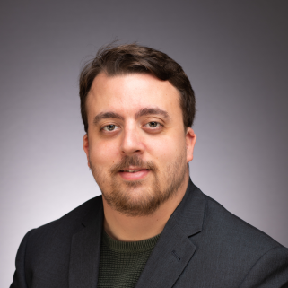
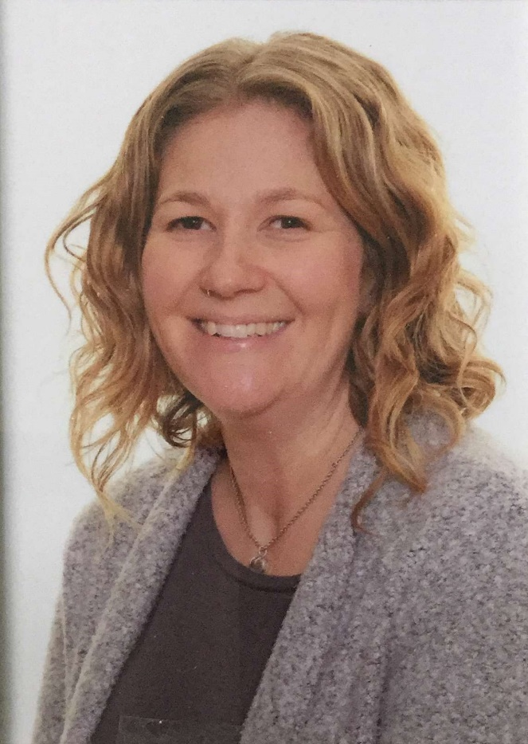
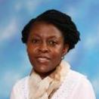
Meet the team.
4H - Mrs Hollick 4W – Mr Williams 4CK – Mrs Cornforth/Mrs Kuma
LSA – Mrs Geddes LSA - Mrs Punt LSA – Mrs Coxon, Mrs Hammond

Slide 3
Topic overview for the year ahead
Autumn – Why do we remember the Romans?
Spring- What is it like to be Danish?
Summer - TBD

Slide 4
Rewards
Our behaviour policy is based on the positive reinforcement of good behaviour. All staff should praise children and give them encouragement when possible.
Rewards/encouragement may include:
House Points
A raffle ticket and Secrets of Success star
Class marble time
Individual charts and incentives
Star of the week
Feedback in books about work

Slide 5
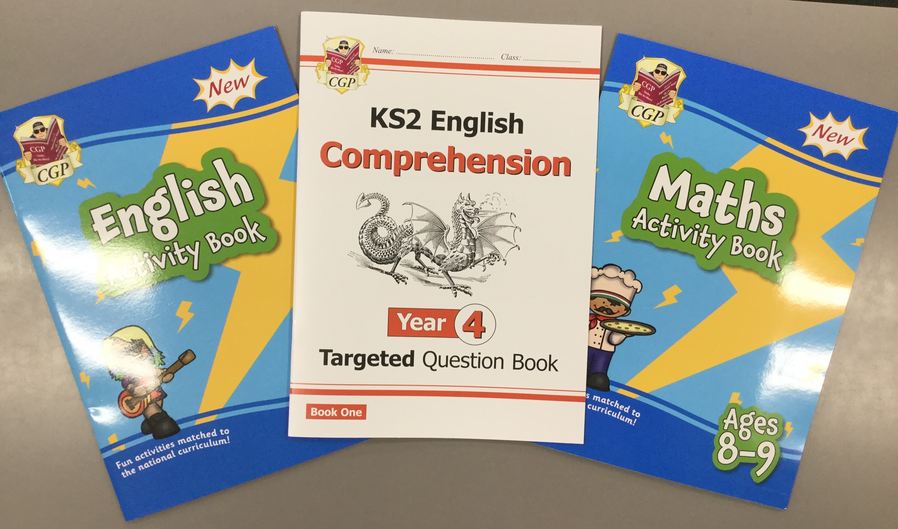
Home Learning expectations
Children should be practising their no-nonsense spelling and times tables regularly. This should be recorded in the green Learning Journals.
It is expected that children will be heard reading/read independently, for about 10 minutes each day, minimum of 5 times a week. This should be recorded in the Pupil Passport and signed by an adult.
Children have access to TT Rockstars + TT practice (passwords are in Pupil Passports).
Children will also have three exercise books to complete activities in.
Maths and English - Weekly
Reading Comprehension – Fortnightly
These books will be required to be in
school each Friday for class marking.

Slide 6
PE days and kit
Tuesday and Wednesday afternoons: Outdoor P.E (games)
Trainers, white P.E t-shirt (with or without logo), black shorts (summer) or plain black tracksuit trousers (winter), school cardigan or sweatshirt, plain white socks.
Children may need a light jacket for outdoor games. It is advised that children bring old trainers for outdoor use, if it is muddy.
For all P.E activities:
Hair needs to be tied back and earrings need to be taken out before school – not taped over.
Please note that due to the current Covid 19 guidance, children are required to attend school in PE kit on PE days.

Slide 7
School Equipment
Pencil cases
Children are required to bring in their own pencil case and to have their own coloured pencils.
ALL other stationery will be provided by the school and personal to each child.

Slide 8
How to keep in touch
Appointments should be arranged via the office and parents will be required to adhere to social distancing guidelines.
Notes can be sent via Pupil Passports.
LSA/ class teacher can be approached in the morning, if required. This should, however, be brief.
Please note that masks are required to be worn on the school site at all times.

Slide 9
Policies and Useful information
Please visit the school website for guidance on a variety of useful topics:
safeguarding
calculation policy
behaviour for learning policy
school newsletters
school meal schedule
term dates

