Slide 1
Parent Information Meeting
Y6 Thursday 19th September 6pm

Slide 2
Topic Overview
Autumn Term – Discover (History focus)
Is war ever worth it?
Spring Term – Explore (Geography focus)
Summer Term – Create (Art/DT)

Slide 3
Events and trips throughout Y6
Trip to Isle of Wight;
Enterprise project;
Crucial Crew;
End of year production;
Leavers’ assembly;
Bikeability;
Trip to Chelmsford Museum;
Transition to Y7 workshops;
Drama Workshop

Slide 4
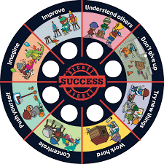
Behaviour for Learning
The whole school uses a simple, visual triangle for monitoring behaviour.
Notes:
Getting into Gold: This is for children who exceed expectations and go above and beyond in one of our ‘Secrets of Success’ traits.
Green: This represents our standard level of expectations for each child. Children begin every day in green regardless of the day before.
Amber: If a child’s behaviour falls below our expectations of them, then their name may be moved into amber. This gives the child a visual warning that they need to make better choices of behaviour.
Red: If the child’s name is placed in the red zone, it means that the child will receive a ‘red card’ and the parent will be informed that this has happened.

Slide 5
Behaviour for Learning
Our behaviour policy is based on the positive reinforcement of good behaviour. Rewards include:
Getting to gold (raffle ticket + sticker on chart)
House points
Star of the week
Head teacher’s award
Golden/marble time
Other incentives decided by class teacher

Slide 6
PE
Outdoor PE (games) – Tuesday and Wednesday
Indoor PE (dance/gymnastics) – Thursday
Colchester United PE – every 4th Friday
PE kit should be in school every day as we use it for the daily mile in addition to PE lessons
Jewellery should be removed before PE lessons – an appropriate container must be brought in for earrings
Pupils should have tracksuit bottoms and a PE jumper or tracksuit top to keep warm during the winter months.

Slide 7
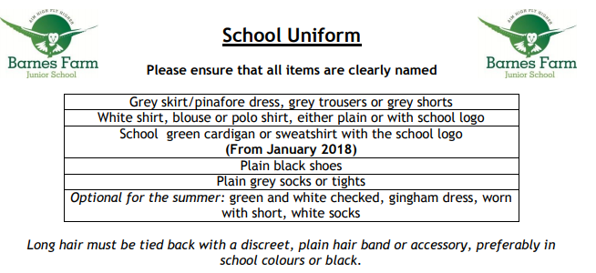
Pupils should also have a suitable coat in school every day.

Slide 8
Home Learning Weekly Expectations before October half term:
Half term project – Is war ever worth it? Children have a sheet in their learning journal with more information.
Reading – daily for at least 15 minutes; pupils can choose a book from the school library or one from home
Spellings – practice words of the week and other spellings patterns taught in class
Times Tables
Abacus – sheet handed out in class and stuck into Learning Journal – answers online through their abacus account. Bring in learning journal on a Thursday to be checked.

Slide 9
Home Learning Weekly Expectations after October half term:
Achieve 100 revision books The pupils have been given a separate revision book for each of the areas listed below along with a study book (which must be returned at the end of the year). Homework is due in on these days; we will go through the pages that have been set in lesson time:
Reading - Monday
GPS - Tuesday
Maths - Wednesday
Reading – daily for at least 15 minutes; pupils can choose a book from the school library or one from home
Spellings – practice words of the week and other spellings patterns taught in class
Times Tables

Slide 10
Keeping in Touch
Parent consultations January/April
Drop-ins – Tuesdays from 3:15pm
Make an appointment via the office if necessary
Pupil passport – communication page
Further information can be found on the school website or in the pupil passport.

Slide 11
Q & A in classrooms

