Slide 1
Parent Information Meeting
Y5 Weds 18th September 6pm

Slide 2
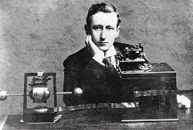
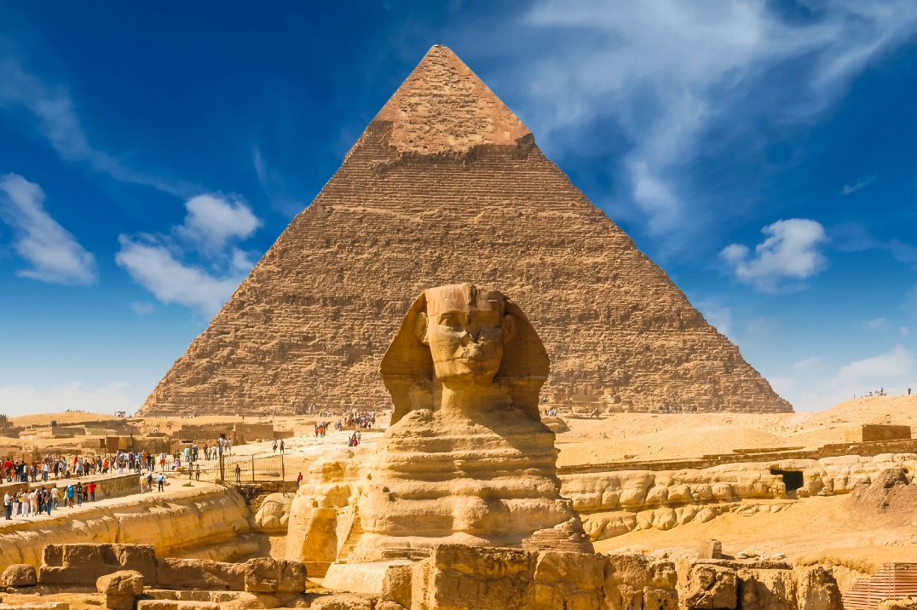
Overview of Topics
Spring Term
Chelmsford( birthplace of Radio)
Electrical Circuits
Living Things (cont.)
Autumn Term
Ancient Egypt
Materials
Living Things
Summer Term
Ancient Greece (Olympic games)
Earth and Space
Notes:
Liz

Slide 3
Trips and in-school events
Project days/trips to be confirmed
Road Safety
Mersea
Secondary school visits- Sandon, Baddow, Boswells and hopefully Beaulieu Park
Cricket coaching
Chelmsford’s Gotta Dance
Notes:
Juliet

Slide 4
Behaviour for Learning
Triangle
Golden tickets
Secrets of Success
Notes:
Hannah

Slide 5
Home Learning
Notes:
Hannah

Slide 6
Our topic this term is What was it like to be an Ancient Egyptian?
This half term we will focus on: gods and goddesses; life in Ancient Egypt; slavery; buildings; afterlife; writing (hieroglyphics); clothes and jewellery and art.
We would like the pupils to complete a half term project focussing on an aspect of Egyptian life such as:
Religion
Pyramids
Stories (eg Moses and Tutankhamun etc.)
Family life
Mummification
Art
Hieroglyphics
Children can present their research in a variety of ways such as: Power point, diary entries, information text, diagrams, 3D model or any other way they wish.
The project should be handed in by the Friday of the first week after half term – Friday 8th November
Notes:
juliet

Slide 7
Reading Books
Books in the school library are sorted into levels which match the Essex Library’s levels. We assess the children‘s reading levels and they can choose a book from the proper level accordingly. A child should be able to self assess their ability to access a book using the 5 Finger Strategy. This could include non-fiction. Children should be reading books that they can read confidently without support.
S books contain content suitable for all year groups. S+ books are aimed at Years 5 and 6.
Notes:
Liz

Slide 8
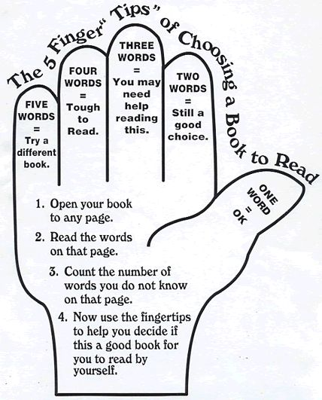
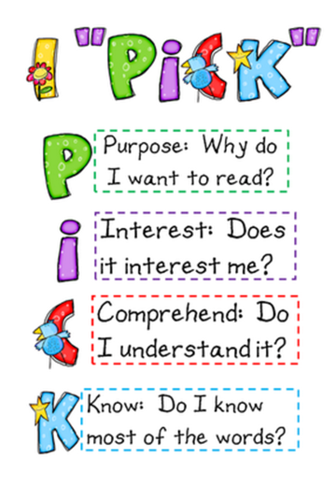
Reading Books
Notes:
Liz

Slide 9
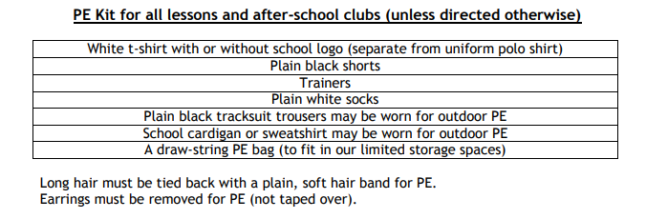
PE
Outdoor PE Wednesday – Games
Indoor – Monday Dance/Gym
PPA Games Thursday 2 out of 3 weeks.
Colchester Utd 1 x each 4 weeks – Games afternoon
PE socks to change into
Notes:
Juliet

Slide 10
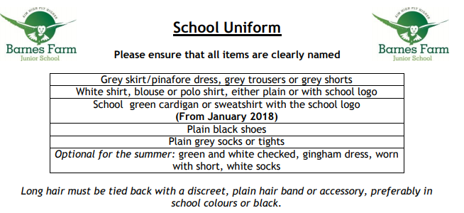
Notes:
Juliet

Slide 11
How to keep in touch
Drop-ins Thursday 3:20 – 4pm
Communication sheets in back of Pupils Passport
Message to LSA on door, early morning
Make an appointment via office if necessary
Notes:
Liz

Slide 12
In each classroom
Behaviour triangle
Login to TT Rockstars
Login to Abacus
Questions
Information available on website
Notes:
Back in class

