Slide 1
Calculation Workshop for Parents
Barnes Farm Junior School

Slide 2
Contents
- The New Curriculum – what’s new in Key Stage 2
- The 4 operations – including methods used and
Progression
Fractions
Times tables
How you can help at home
- Online resources

Slide 3
The New Curriculum
New Expectations:
By the end of year 4 pupils should
- memorise their multiplication tables up to and including the 12 times table
show precision and fluency in their work
By the end of year 6 pupils should
- Be fluent in written methods for all four operations,
including long multiplication and division, and in working
with fractions, decimals and percentages.
Pupils should read, spell and pronounce mathematical
vocabulary correctly.

Slide 4
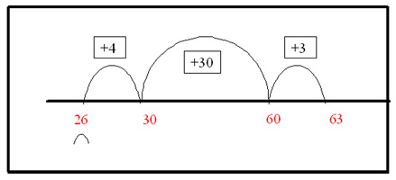
Addition – Lower KS2
Using an empty number line.
26 + 37 =

Slide 5
Addition - Expanded column method:
383 + 464 =
300 80 3
400 60 4
700 140 7
= 847

Slide 6
Addition - Column Method:
This method remains efficient when adding larger numbers and decimals. It is a quick and reliable method.
4 8 0
3 6 2+
8 4 2
1 carrying ‘one hundred’

Slide 7
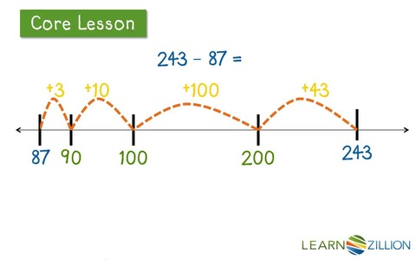
Subtraction - Counting On ‘Finding the difference’
243 – 87=

Slide 8
Subtraction - Column Method (Decomposition):
This method is the most efficient for subtraction. However it relies on the children’s understanding of place value due to the need to ‘borrow’ tens or hundreds if the number being subtracted is larger than the number being subtracted from.

Slide 9
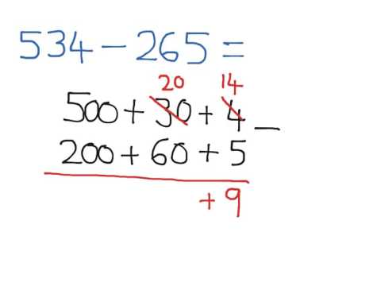
Subtraction (Expanded column method):
400__
1
200 + 60 + 9
= 269

Slide 10
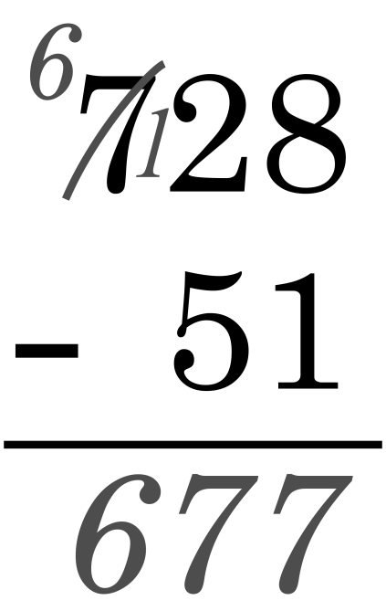
Subtraction - Column Method (Decomposition):
Borrowing a hundred not one!

Slide 11
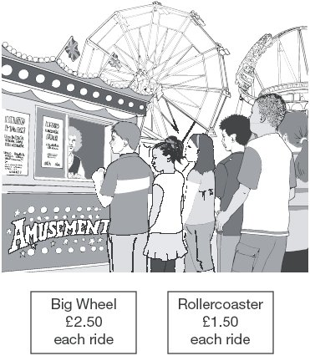
Now it’s your turn!
Liam spends £14 altogether on the Big Wheel and the Rollercoaster.
He goes on the Big Wheel twice.
How many times does he go on the Rollercoaster?

Slide 12
Now it’s your turn!
Dev and Joe each buy a book.
Dev pays with a £5 note and gets £1.05 change.
Joe’s book costs £7
How much more does Joe’s book cost than Dev’s book?

Slide 13
Multiplication – Partitioning:
4 3 X 6 = 4 0 x 6 = 240
3 x 6 = 1 8 +
2 5 8
Once again Place Value is essential
so children can understand why 40 x
6 = (4 x 6) x10
Children learn to multiply the
tens first and then the units.

Slide 14
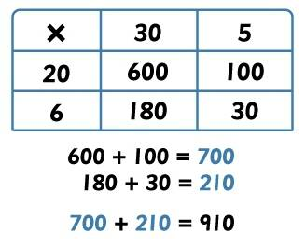
Multiplication –Grid Method:

Slide 15
Long Multiplication – Formal Method
2 4 1 9 2

Slide 16
Now it’s your turn!
Calculate 602 × 57
2. Calculate 143 × 37

Slide 17
Short Division :
81 ÷ 3 =
2 7
3 8 1
2

Slide 18
Long Division:
https://www.activelearnprimary.co.uk/resources#quick_search
6.17

Slide 19
Long Division
200 + 30 + 3
24 5600
4800
800
720
80
72
8
1 x 24 = 24 2 x 24 = 48 3 x 24 = 72 4 x 24 = 96 5 x 24 = 120
Answer =
1
3

Slide 20
Now its your turn!
Calculate 816 ÷ 24
2. A school buys some yo-yos as prizes.
The yo-yos cost £4.25 each.
The school has £40 to spend on prizes.
They buy as many yo-yos as they can.
How much money is left?

Slide 21
Mental Maths
It is essential children have secure knowledge and recall of mental facts including:
- Place Value including decimals
- Number bonds to 10, 20, 100 and beyond
- Times tables from 0 to 12 with corresponding division facts.
- multiply and divide by lots of 10
Multiply by 5 mentally (multiply by 10 and halve)
Multiply and divide by 4 and 8.

Slide 22
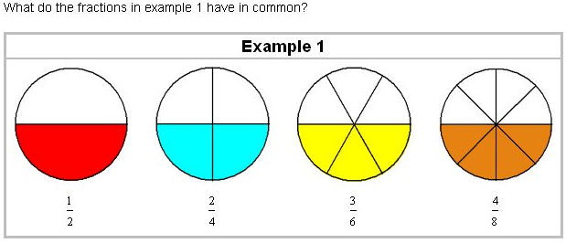
Fractions:
It is important children understand that a fraction is part of a whole. We begin with pictorial representations of fractions and then move on to understanding equivalent fractions.
Abacus QM6.8.4

Slide 23
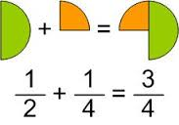
Finding a Fraction of a whole number
Abacus 6.18.3
Adding Fractions
1 + 1 = 3
2 4 4

Slide 24
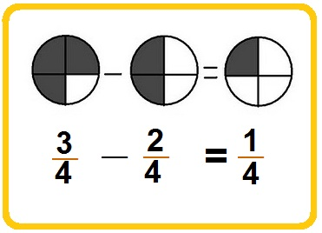
Subtracting Fractions
3 - 1 =
4 2
3 - 2 = 1
4 4 4

Slide 25
Multiplying Fractions
2 X 1 = 2
5 5 25
Dividing Fractions
1 ÷ 3 = 1
2 6

Slide 26
Now its your turn……
Use the dice on your table to either add, subtract or multiply fractions.
Got it? Then use a fraction dice and a regular dice and try dividing!

Slide 27
Learning Times Tables
Stick to one times table at a time
Count in lots of that table (e.g. 2, 4,6, 8 etc)
Chant and write them out slowly in order (times tables songs from you tube or CDs can also be useful)
Complete the answers quickly in order - on paper or verbally
Finally move on to completing the answers in any order

Slide 28
….. cont
Keep reminding your child that 3 x 4 is the same as 4 x 3 - this effectively halves the number of tables facts
Use cards to help learn tables out of order. Write answers on the back so children can test themselves.
Finally, learn division facts i.e. how many 6s in 48 etc

Slide 29
Useful websites for Learning Times Tables
http://www.multiplication.com/ has other ideas for teaching tables, particularly if there is a fact children are finding hard to remember.
Percy Parker http://www.teachingideas.co.uk... - Percy has songs, software and an iPhone / iPad app to reinforce knowledge of times tables.
www.learn-timestables.com.
http://mathematicsgames.wordpr...
www.topmarks.co.uk/flash.aspx?...
Put an action to each table. E.g.:- if you were doing the 3 times table you could do star jumps to every digit.

Slide 30
How you can help at home
- Lots of practice – refer to ‘weekly destinations’ to see what has been taught that week.
- Playing games – cards, snakes and ladders, dominoes
Telling the time
Measuring and weighing - convert from one unit of measures to another.
Online Applications http://www.bbc.co.uk/education/subjects/z826n39
http://www.transum.org/Software/SW/Starter_of_the_day/
http://mathszone.co.uk/
Abacus homework and resources.

Slide 31
Thank you for your time!
Any questions?

