Slide 1
What’s on my plate?
Monday 16th October 2017

Slide 2

Global Goals

Slide 3

What’s on my plate?

Slide 4
Special targets

Slide 5
Our new Winter menu

Slide 6


Slide 7
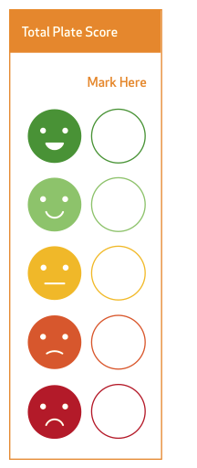
Analyse your plate

Slide 8

Food miles

Slide 9
Work out your score

Slide 10

World’s largest lesson

Slide 11
Half term challenge
Email sent to parents
Pick a plate
Analyse it!
Take a photo if you can
Record on the sheet
Return it by email or bringing it in
Add Chelmsford to the map!!

