Slide 1
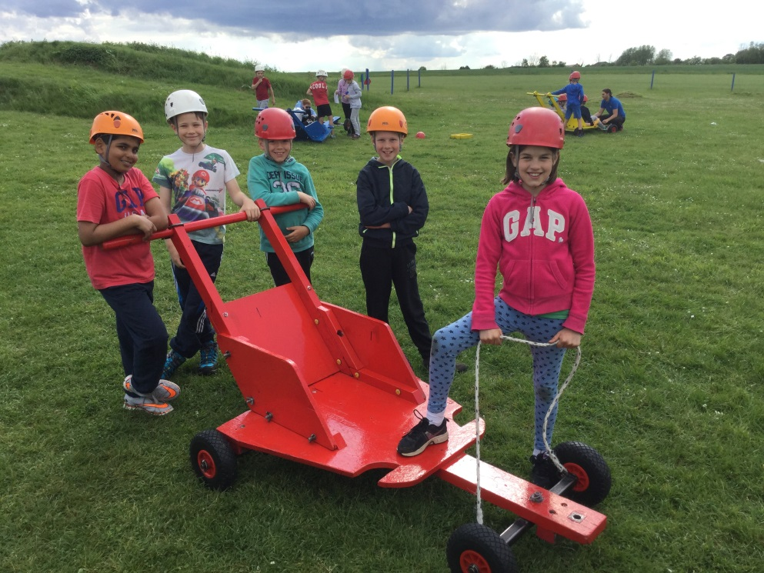
Mersea Residentials 2021 For more information please visit Essex Outdoors Mersea Website
Y5 Monday 28th June – Wednesday 30th June
Y6 Monday 12th July – Friday 16th July

Slide 2
Covid-19 Implications
Non-overnight domestic visits are allowed
Mersea-type visit most likely to be permitted
Full refund if Covid-affected
Local
Experienced
Outside!

Slide 3
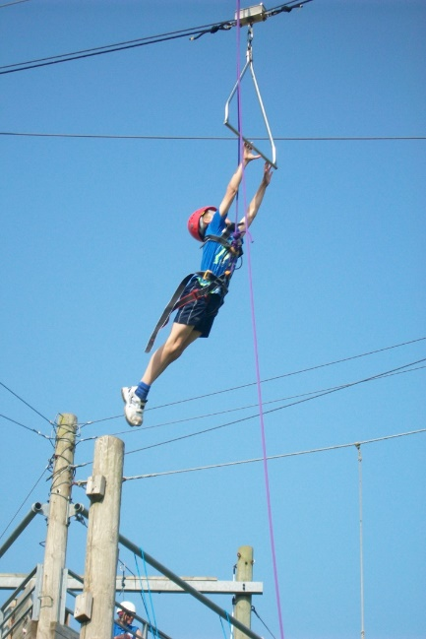
Why take pupils outdoors?
Outside their comfort zone.
Helps them to better tackle uncertainty and manage risk.
Well run – 24/7
They love it!

Slide 4
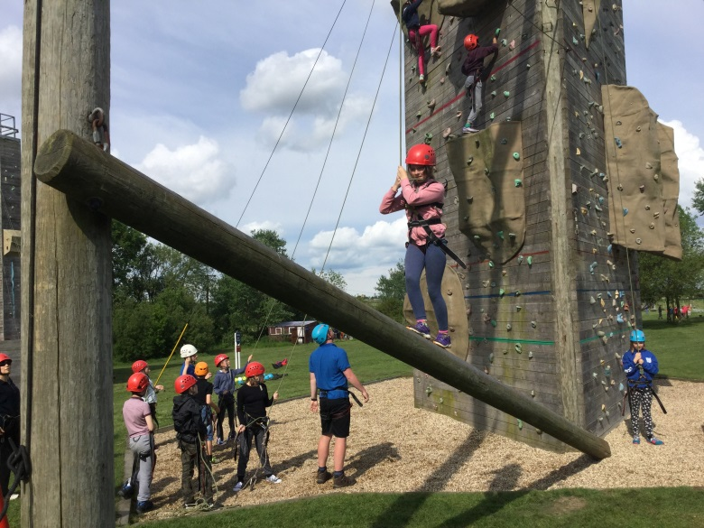
Format of trip 2021
A 3 day or 5 day residential trip with accommodation under canvas and instructor-led adventurous activities undertaken throughout the visit
Monday
Arrive at school as usual
Depart mid morning
Arrive at site and set-up tents
Lunch
Activities 1 + 2
Dinner
Activity 3

Slide 5
Format of trip 2021
Tuesday
Breakfast
Activities 4 & 5
Lunch
Activities 6 & 7
Dinner
Evening activity organised by school staff – Beach walk

Slide 6
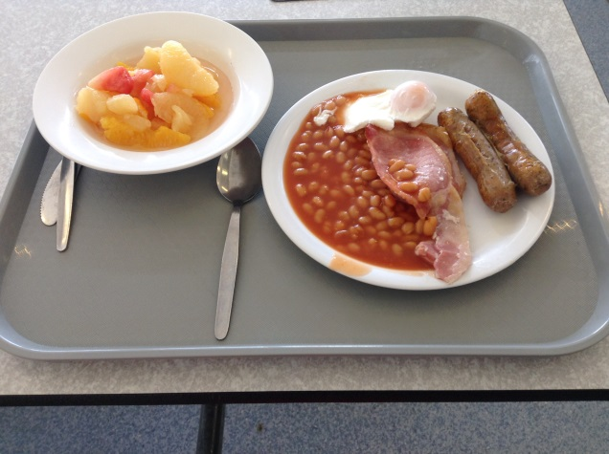
Format of trip 2021
Wednesday – Y5 only
Breakfast
Final activity
Pack-up
Lunch
Leave and arrive back at school for normal end of day.
Thursday/Friday – Y6
Continue activities then follow agenda above on Friday
New for 2021 – watersport activities!

Slide 7
Other Information
Staffing – Regular teaching staff plus some support staff
Qualified instructors lead all adventurous activities
We may need parent volunteers – please let the Office know if you can support this
total cost – £144 (Y5)/ £291(Y6) includes all board, activities, travel and food.
£40 deposit

Slide 8
Other key information
Equipment – see kit list
Medication – Form to be filled in June 2021
Final FAQ meeting in June 2021 (TBC)
Final reminders letter in May 2020
Communication
- School Mobile 24/7
- Twitter
- Website
- Dropbox access for photos

Slide 9
Other Information
Please discuss sensitive issues with the class teacher well in advance.
Behaviour expectations are the same as at school.
Attendance on the trip is dependent on great behaviour throughout Year 5/6. Any risk to participation will be discussed with parents well in advance

Slide 10
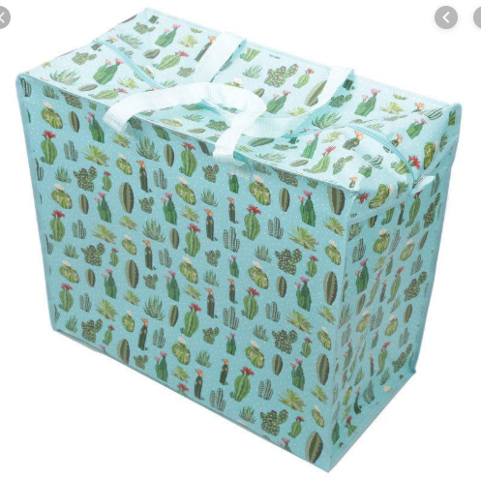
Laundry bag to carry sleeping bag and pillow.

Slide 11
Questions

