Slide 1
Parent Information Year 6

Slide 2
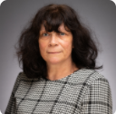
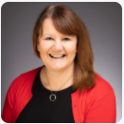
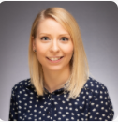
Meet the team:
Miss Cavanagh Mrs Cole Miss Stanley

Slide 3
Topic Overview
Autumn Term – Discover (History focus)
Is war ever worth it? OUTCOME: film project
Spring Term – Explore (Geography focus) Have you got what it takes to survive? OUTCOME: survival guide
Summer Term – Create (Art/DT)

Slide 4
Events and trips throughout Y6 (subject to change due to Covid-19)
Chelmsford Museum workshop;
Bush craft at Skreens Park;
Enterprise project;
Crucial Crew;
End of year production;
Leavers’ assembly;
Bikeability;
Transition to Y7 workshops;
Trip to Isle of Wight.

Slide 5
Relationships for Learning
Our behaviour policy is based on building positive relationships with one another. It aims to promote high standards of achievement for all and enable everyone to feel included, valued and safe.
If a pupil is not following our behaviour policy, consequences will have a clear link to the incident and help the pupil to learn how to behave more appropriately should a similar situation occur.

Slide 6
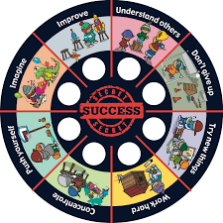
The ‘Secrets of Success’ link to the behaviours we wish to promote in and around the school.
Rewards include:
Sticker on chart and raffle ticket
Certificate following achievement in all areas of secrets of success
House points
Star of the week
Head teacher’s award
Golden/marble time

Slide 7
PE
Outdoor PE (games) – Thursdays and alternate Fridays
Indoor PE (dance/gymnastics) – Mondays
PE kit should be worn to school on PE days
Pupils should have tracksuit bottoms and a PE jumper or tracksuit top to keep warm during the winter months.
Jewellery should be removed before PE lessons – preferably taken out before coming to school

Slide 8
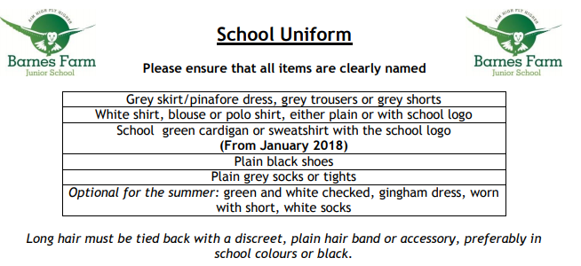
Pupils should also have a suitable coat in school every day.

Slide 9
Home Learning Weekly Expectations before October half term:
Maths and English sheet set weekly on a Friday. Due in the following Thursday.
Reading – daily for at least 15 minutes; pupils can choose a book from the school library or one from home
Spellings – practise words of the week and other spellings patterns taught in class
Times Tables – practise multiplication and division facts (e.g. using TT Rockstars)

Slide 10
Home Learning Weekly Expectations after October half term:
Achieve 100 revision books The pupils will be given a separate revision book for each of the areas listed below along with a study book (which must be returned at the end of the year). Homework is due in on these days; we will go through the pages that have been set in lesson time:
GPS - Tuesday
Reading - Thursday
Maths - Friday
Reading – daily for at least 15 minutes; pupils can choose a book from the school library or one from home
Spellings – practise words of the week and other spellings patterns taught in class
Times Tables

Slide 11
Keeping in Touch
Parent consultations January/April (subject to Covid-19 restrictions)
Appointments with your child’s teacher can be made via the office
Pupil passport – communication page
Further information can be found on the school website or in the pupil passport

Slide 12
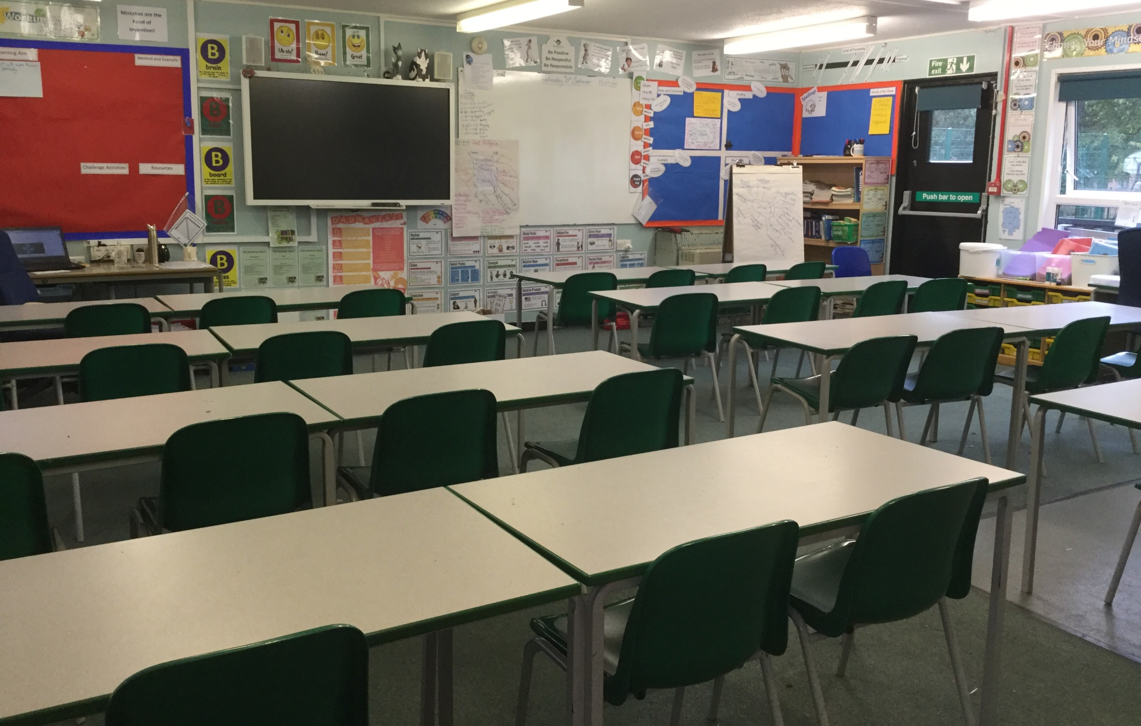
6C Classroom

Slide 13
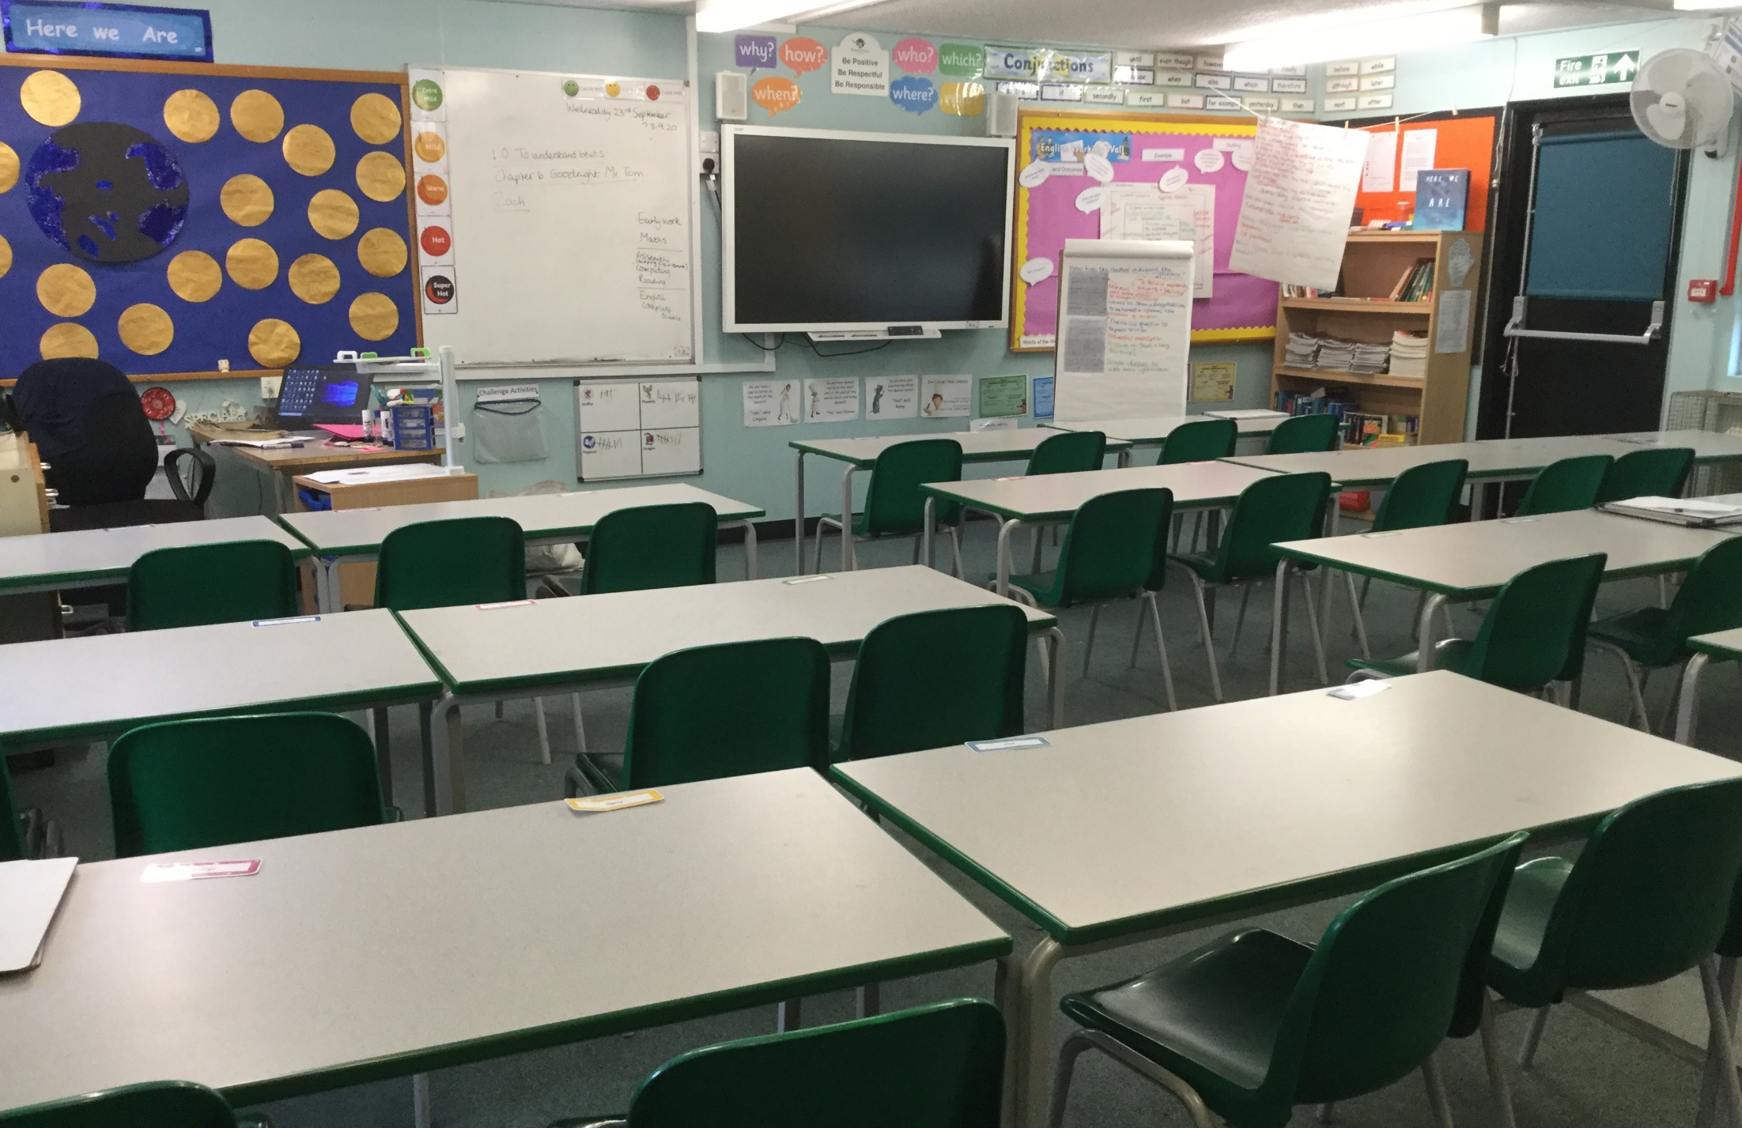
6J Classroom

Slide 14
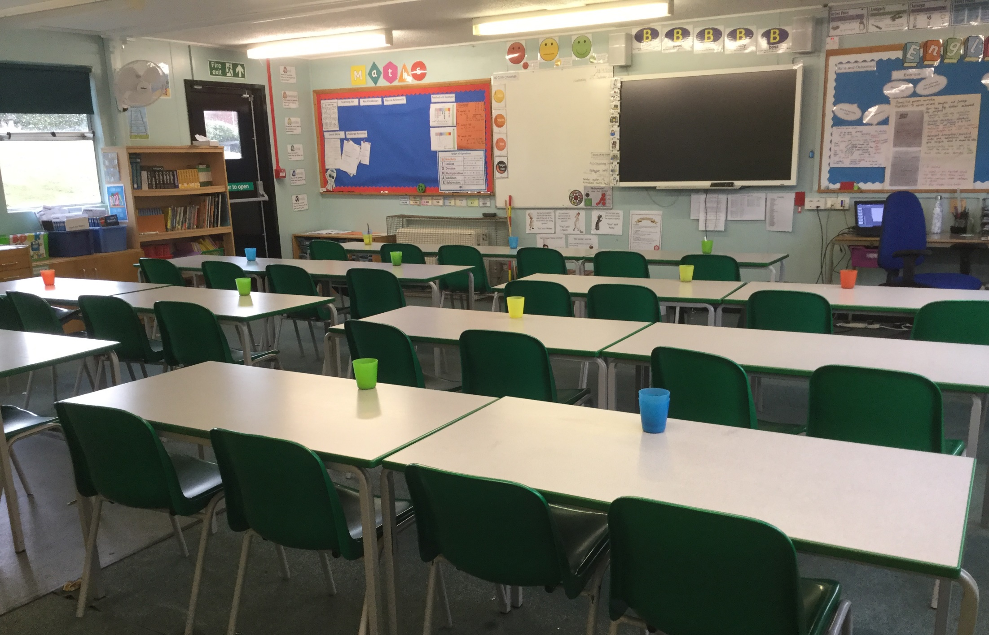
6S Classroom

Slide 15
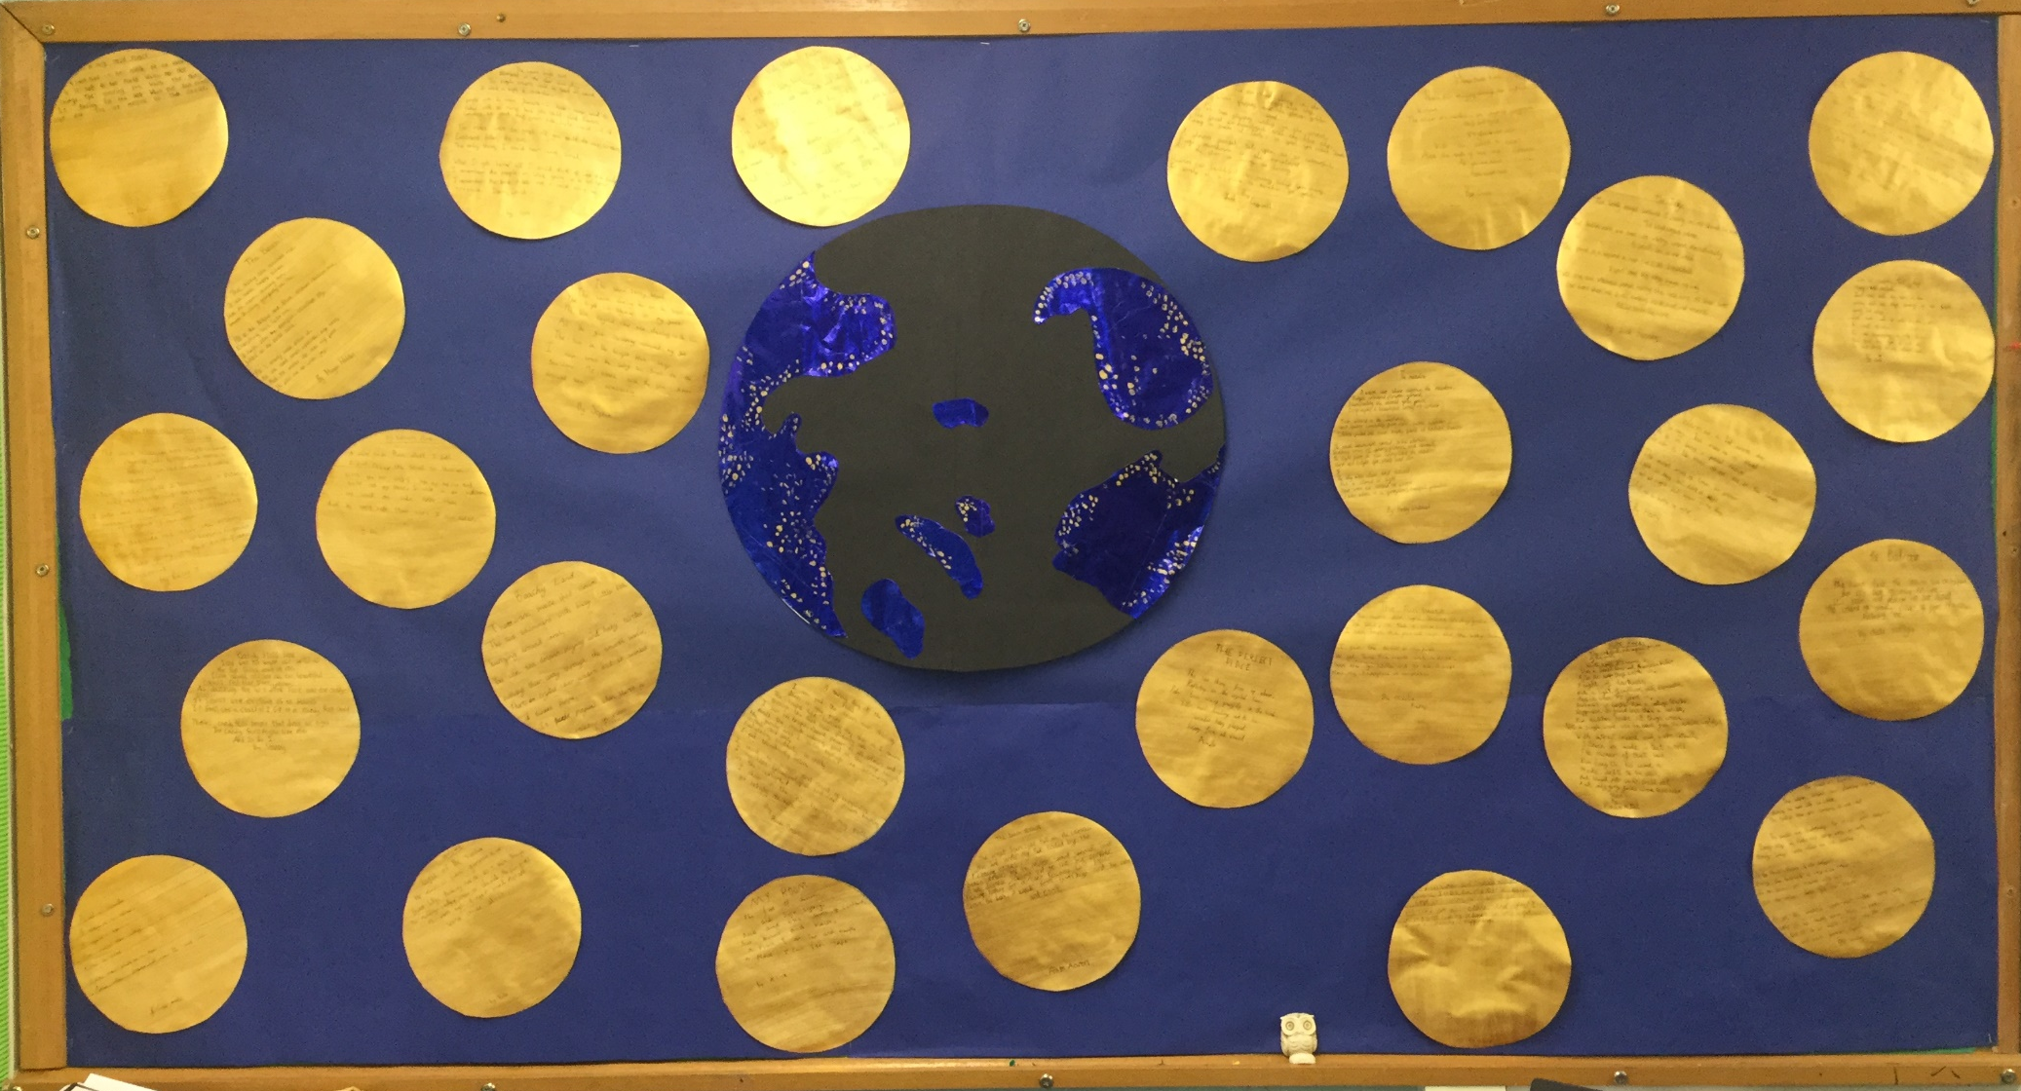
Examples of Year 6 work from the past few weeks, inspired by the book, ‘Here We Are’

Slide 16
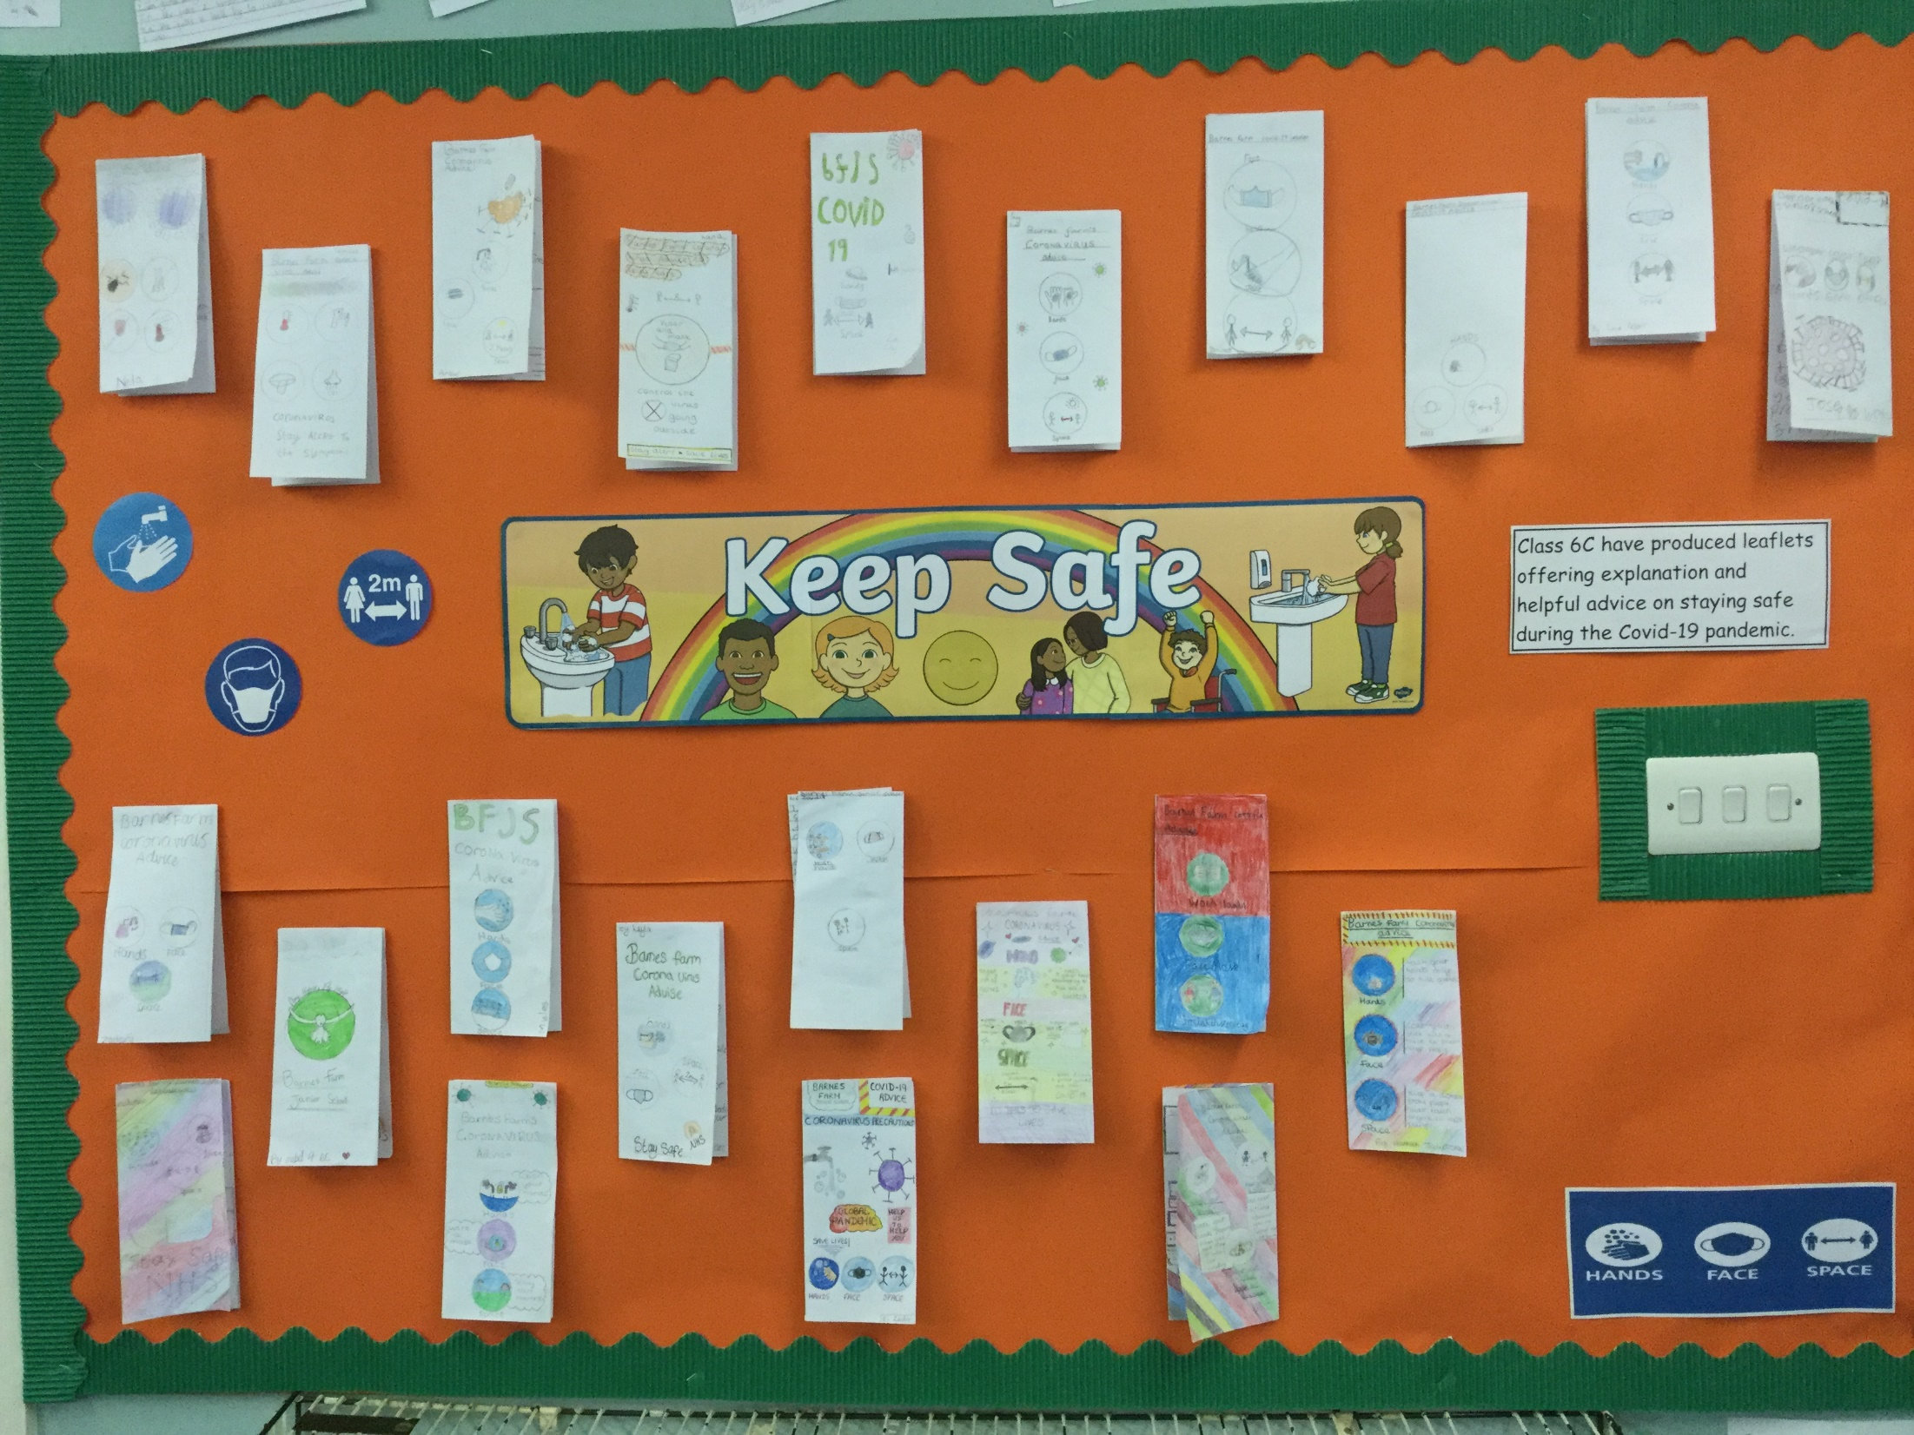

Slide 17
